Slide 1
Operating-System Structure

Slide 2
Simple Structure
Many operating systems do not have well-defined structures. Frequently, such systems started as small, simple, and limited systems and then grew beyond their original scope. MS-DOS is an example of such a system
It was originally designed and implemented by a few people who had no idea that it would become so popular. It was written to provide the most functionality in the least space, so it was not carefully divided into modules
In MS-DOS, the interfaces and levels of functionality are not well separated For instance, application programs are able to access the basic I/O routines to write directly to the display and disk drives. Such freedom leaves MS-DOS vulnerable to errant (or malicious) programs, causing entire system crashes when user programs fail.
Another example of limited structuring is the original UNIX operating system. UNIX initially was limited by hardware functionality. It consists of two separable parts: the kernel and the system programs. The kernel is further separated into a series of interfaces and device drivers, which have been added and expanded over the years as UNIX has evolved

Slide 3
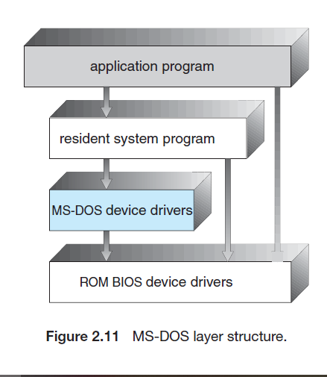
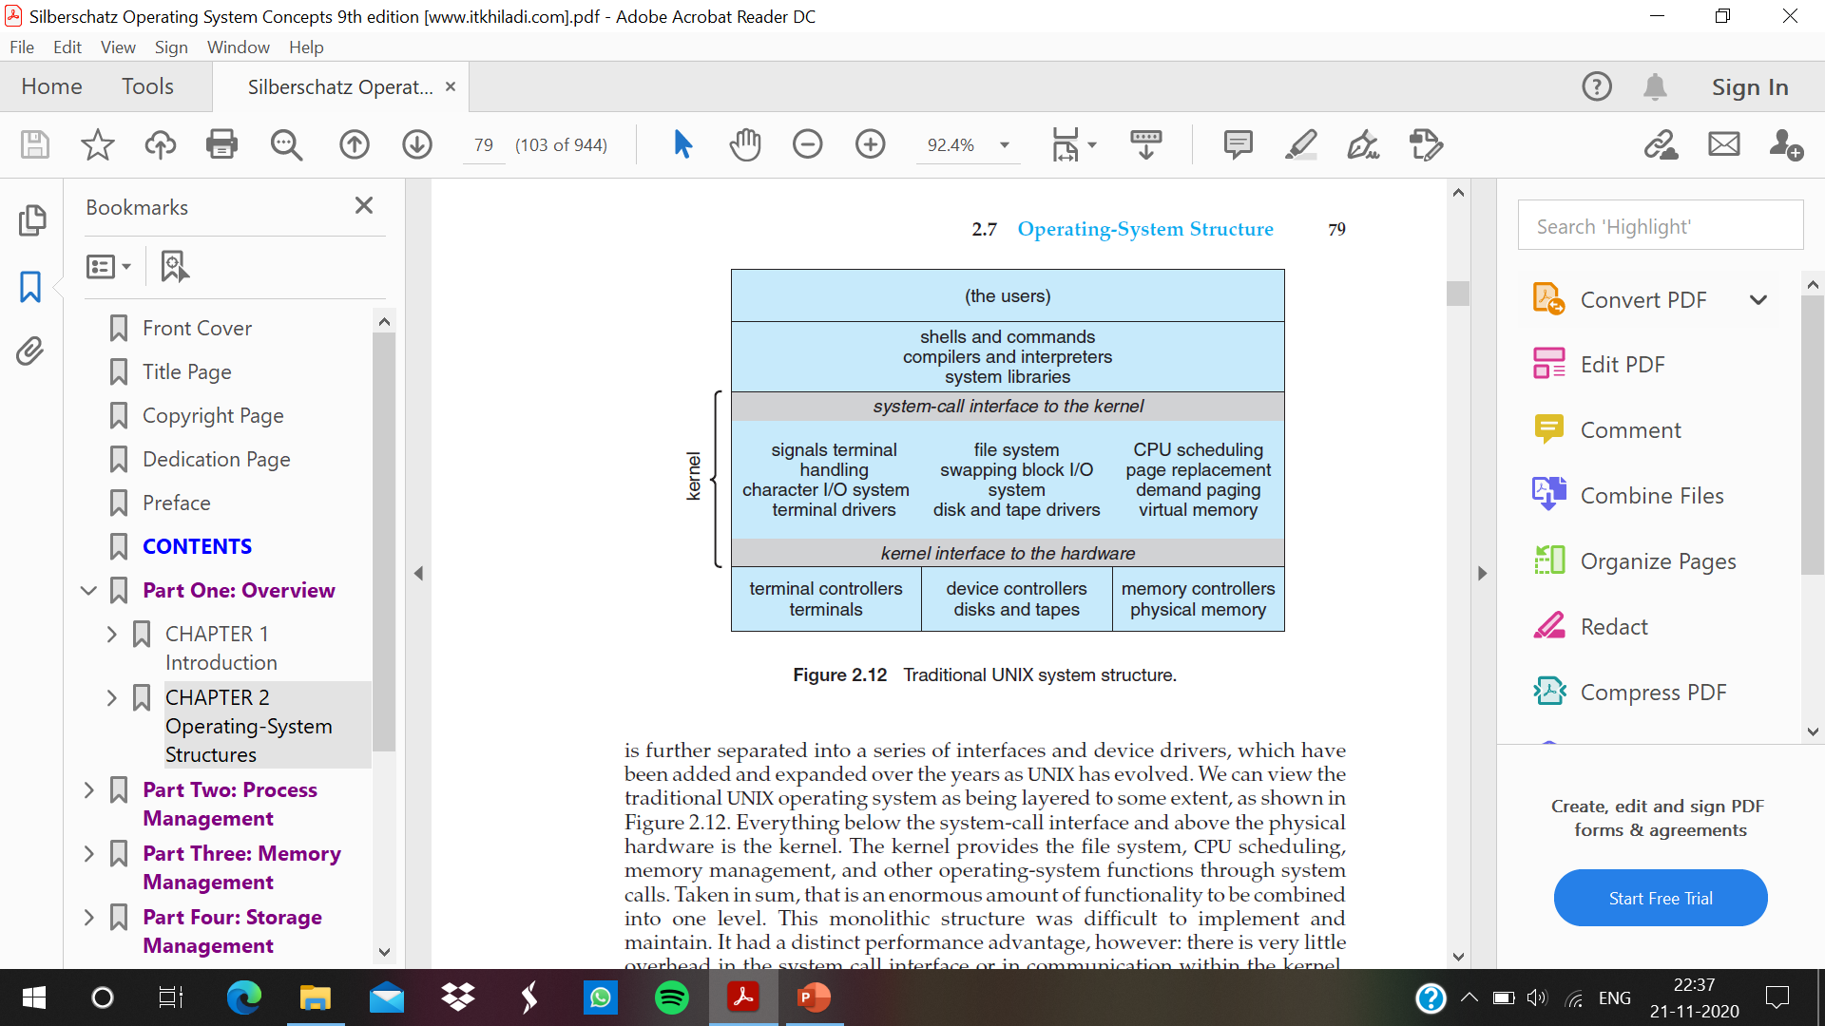

Slide 4
Layered Approach
With proper hardware support, operating systems can be broken into pieces that are smaller and more appropriate than those allowed by the original MS-DOS and UNIX systems.
The operating system can then retain much greater control over the computer and over the applications that make use of that computer. Implementers have more freedom in changing the inner workings of the system and in creating modular operating systems. Under a top down approach, the overall functionality and features are determined and are separated into components.
Information hiding is also important
the operating system is broken into a number of layers (levels). The bottom layer (layer 0) is the hardware; the highest (layer N) is the user interface.
higher-level layers can invoke operations on lower-level layers. The main advantage of the layered approach is simplicity of construction, system verification and debugging. The layers are selected so that each uses functions (operations) and services of only lower-level layers.

Slide 5
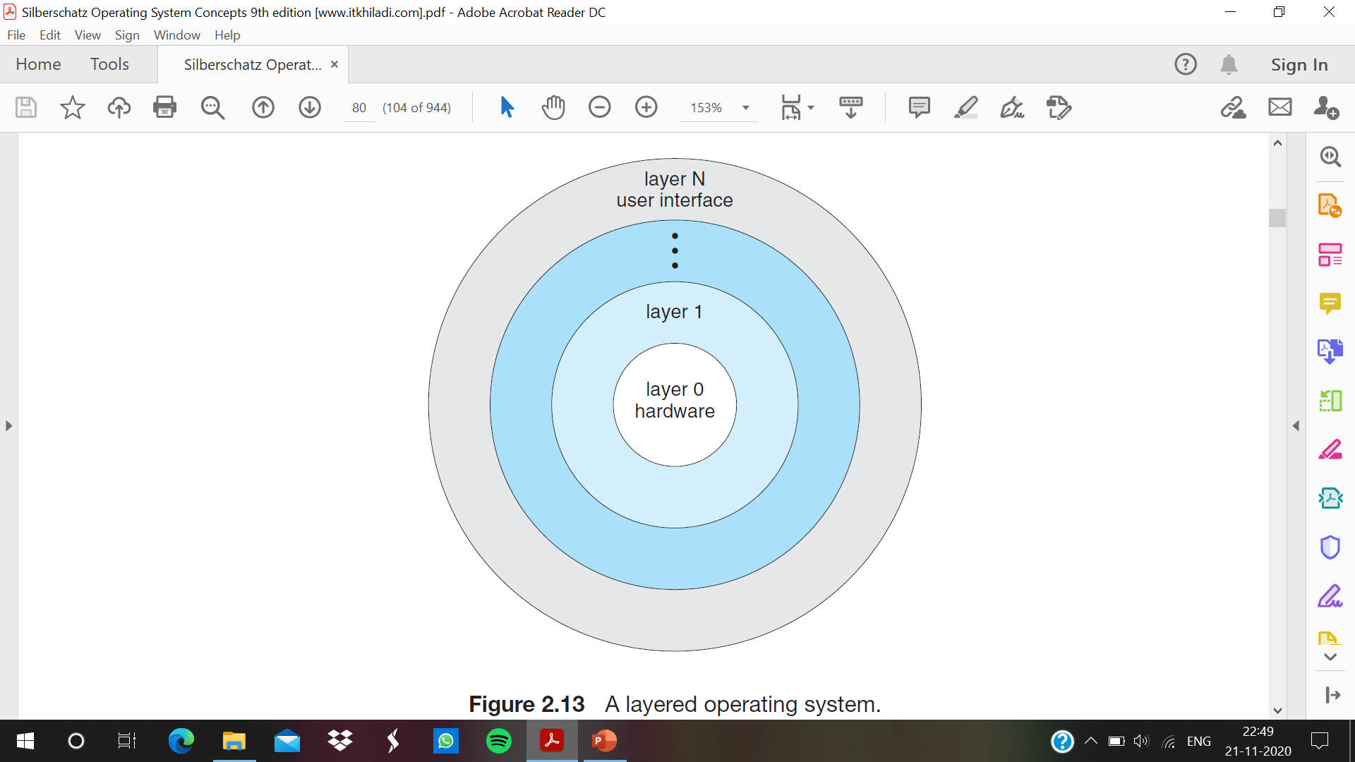

Slide 6
Once the first layer is debugged, its correct functioning can be assumed while the second layer is debugged, and so on. If an error is found during the debugging of a particular layer, the error must be on that layer, because the layers below it are already debugged. Thus, the design and implementation of the system are simplified
Each layer is implemented only with operations provided by lower-level layers. A layer does not need to know how these operations are implemented; it needs to know only what these operations do. Hence, each layer hides the existence of certain data structures, operations, and hardware from higher-level layers.
The major difficulty with the layered approach involves appropriately defining the various layers. Because a layer can use only lower-level layers, careful planning is necessary
A final problem with layered implementations is that they tend to be less efficient than other types

Slide 7
Microkernels
In the mid-1980s, researchers at Carnegie Mellon University developed an operating system called Mach that modularized the kernel using the microkernel approach
This method structures the operating system by removing all nonessential components from the kernel and implementing them as system and user-level programs. The result is a smaller kernel. There is little consensus regarding which services should remain in the kernel and which should be implemented in user space.
microkernels provide minimal process and memory management, in addition to a communication facility.
The main function of the microkernel is to provide communication between the client program and the various services that are also running in user space. Communication is provided through message passing

Slide 8
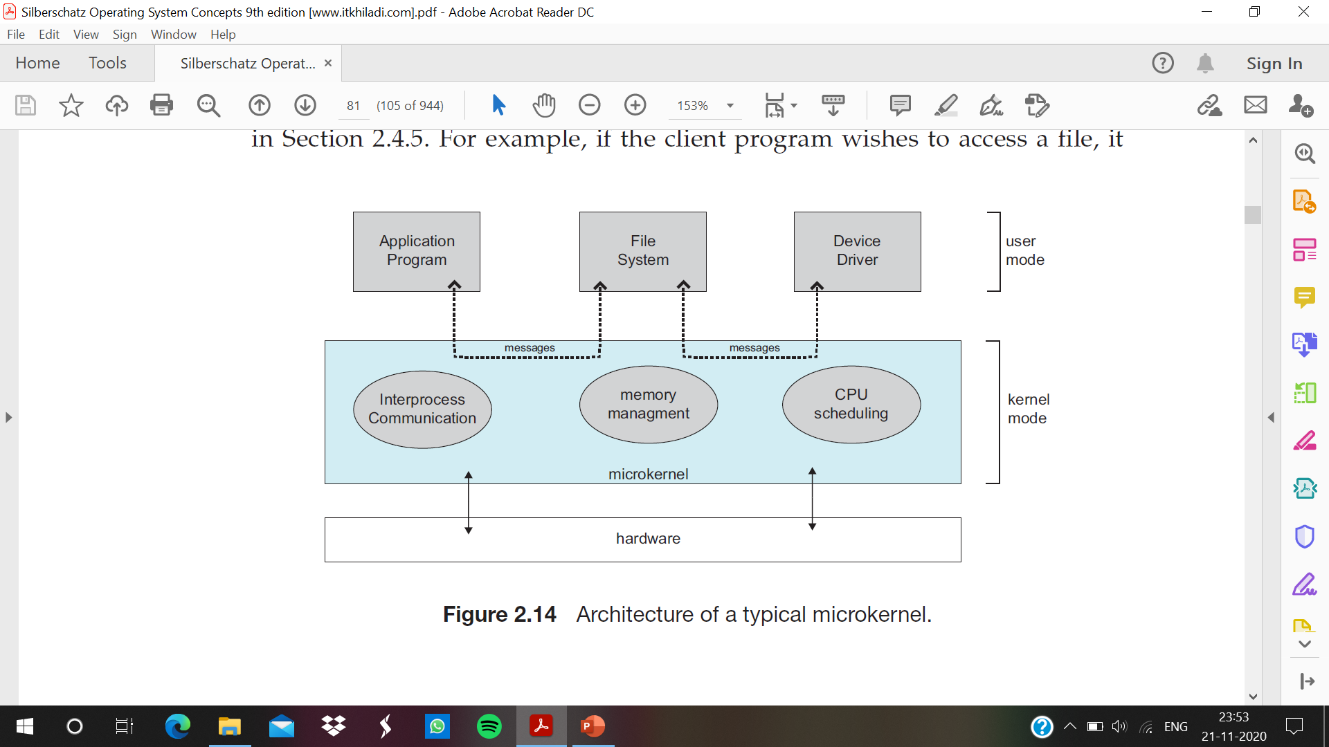

Slide 9
One benefit of the microkernel approach is that it makes extending the operating system easier. All new services are added to user space and consequently do not require modification of the kernel. When the kernel does have to be modified, the changes tend to be fewer, because the microkernel is a smaller kernel
The microkernel also provides more security and reliability, since most services are running as user—rather than kernel— processes. If a service fails, the rest of the operating system remains untouched
Ex-Tru64 UNIX, QNX

